Slide 1
PARC HB OPAMPS SIMPLIFIED (with LTSpice)
Dave VE3OOI
Feb 2021

Slide 2

FOLLOW AND LEARN
This is not a “traditional” tutorial
Its “Hands-On”, experimental approach.
Build experience using LTSpice
Present a “Principal” then clarify with experiment with LTSpice

Slide 3
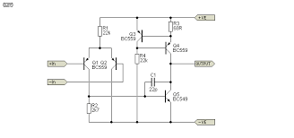

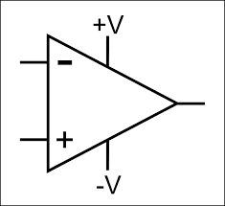

FUNDEMANTALS
Based on a bunch of transistors
Have 2 inputs + (non-inverting) and – (inverting)
Have Positive Supply (+V) and a Negative Supply (-V). Lets call this positive or negative voltage “rails”
Output is based on difference.
Output is 0 if difference between inputs is 0
Generally, output a voltage between voltage rails based on difference of inputs

Slide 4
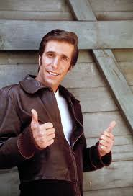

Principal 1: Input Offset Voltage
If voltage at + input is greater than – input, output is set to Positive Rail
If voltage at - input is greater than + input, output is set to Negative Rail
Real opamp has input offset due to mismatched parts and tolerances.
0 voltage difference applied to both terminal does NOT produce 0 volts output
Typical offset between inputs to trigger output to hit Positive or Negative Rail
LT1013 is replacement of LM358

Slide 5
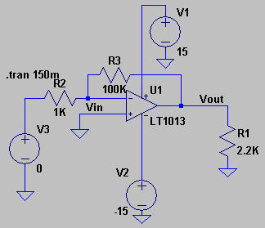
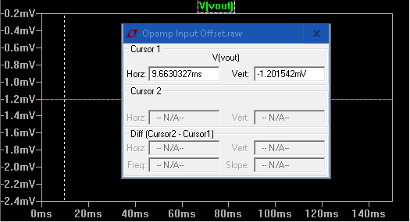
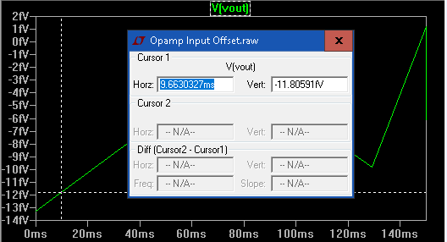
Experiment 1: Input Offset Voltage
1.2mV at output. What input offset is needed?
For Gain = 100, input = 1.201542/100 mV = 12 uV
An input offset of 12uV is needed to make output zero.
This is a simulation. Data sheet says typically 40 – 150 uV and due to MANUFACTURING.
Offset set to -12.0156µV

Slide 6
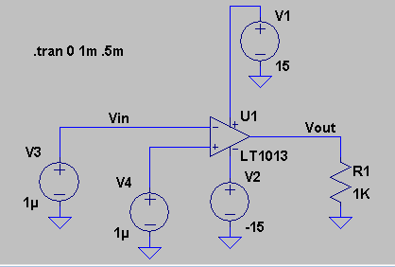
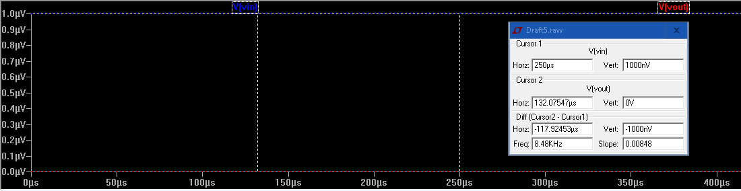
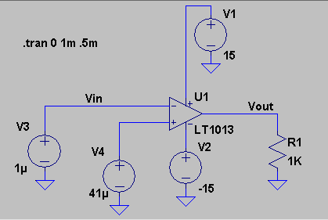
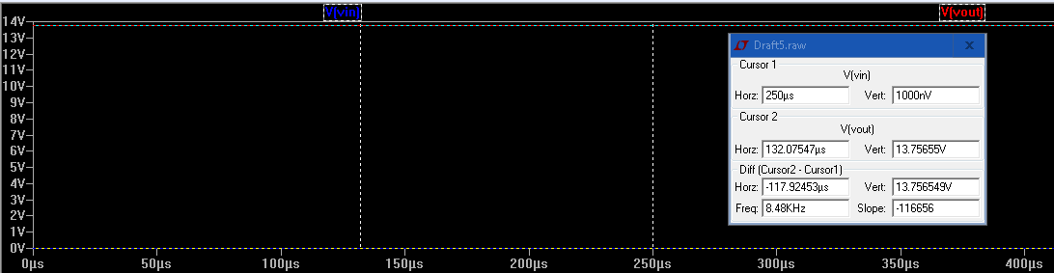
Experiment 2: Input “Offset” Voltage
+ & - are equal so output = 0
Whatttt? Gain of 14V/40uV=350K or 615 dB
+ & - difference is input “offset” voltage
so output “should be” = Positive Rail
HOMEWORK:
Vary the input. Is it linear between 0-40uV?
What happens if you ground the negative supply?
Huh?

Slide 7
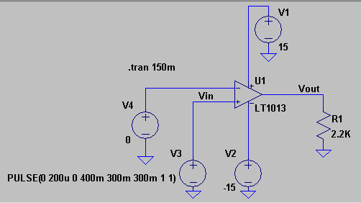
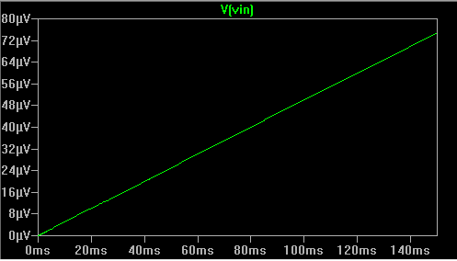
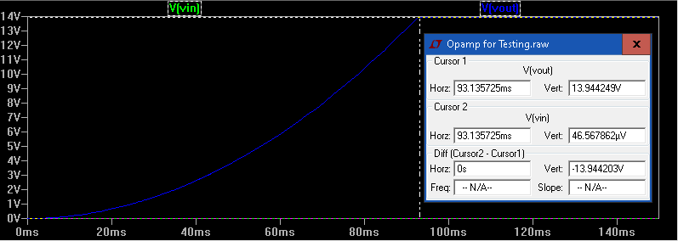

Experiment 3: Alternate View of “Offset”
Opamp DOES NOT set output to positive or negative rail with a small offset. Huh?
75uV

Slide 8
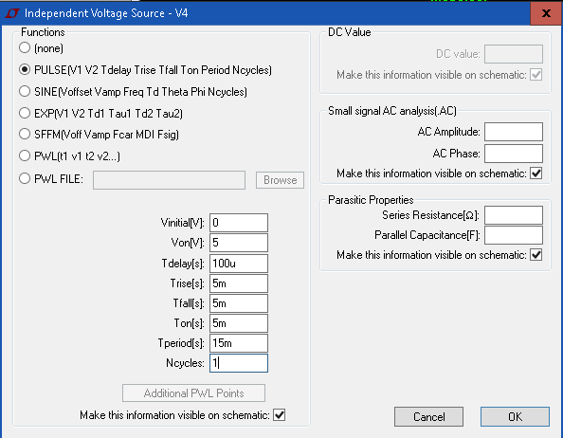
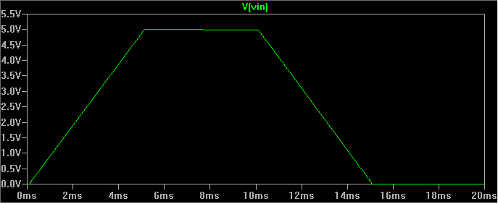
LTSPICE MINUTE: PULSE SOURCE

Slide 9
Rail to Rail
Many opamps don’t swing to the voltage rails. This reduces the useful limit of an opamp. BEWARE!!
Opamps that swing to both rails are called “rail-to-rail” opamps
FINDING 1:
Opamps have a HUGE gain!
Small input voltage can create output close to or equal to rail voltage

Slide 10
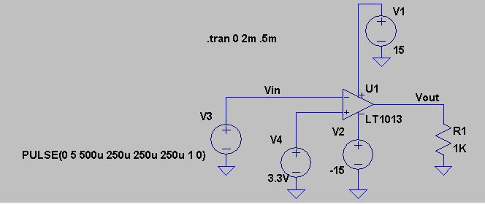
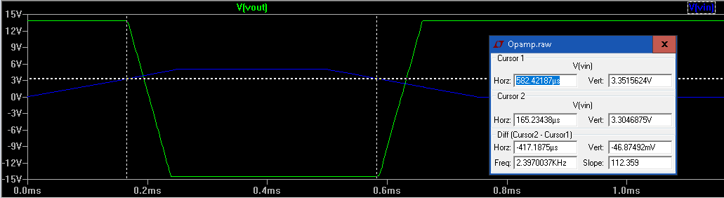
Experiment 4: Comparator
Can be used to identify when a voltage is below, at or above a reference voltage

Slide 11
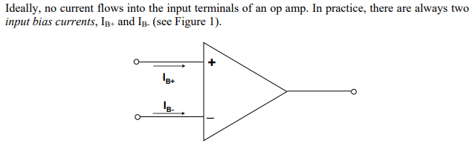
Principal 2: Input Bias Current
Ideal Opamps have a infinite input impedance
Ideal Opamps should therefore have NO current should flow at inputs
Differential Mode: Input voltages relative to each other. Voltage different at terminals
Common Mode: Input voltages relative to ground. Same voltage at inputs

Slide 12
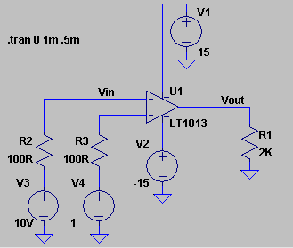
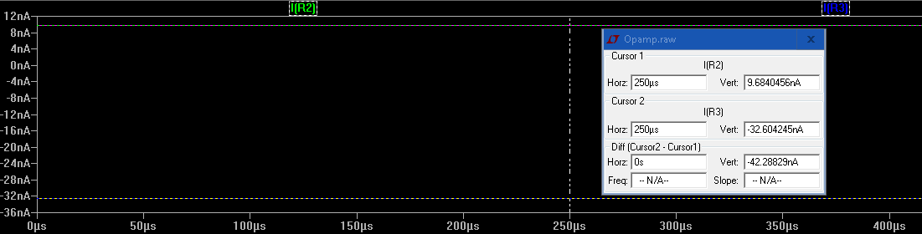
Experiment 5: Input Bias Current
FINDING 2:
Opamps consume negligible amount of current at input – this makes math EASY!!

Slide 13
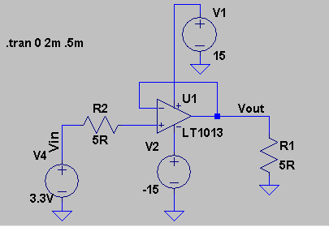
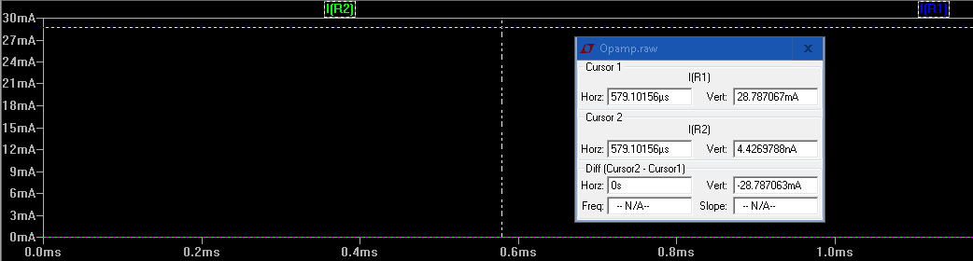
Experiment 6: Output Current
Use 2 current sensing resistors to measure input and output current.
FINDING 4: Opamps can have huge current gain!

Slide 14

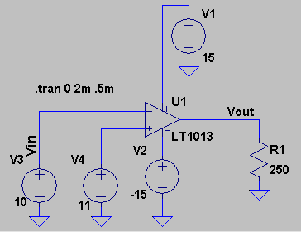
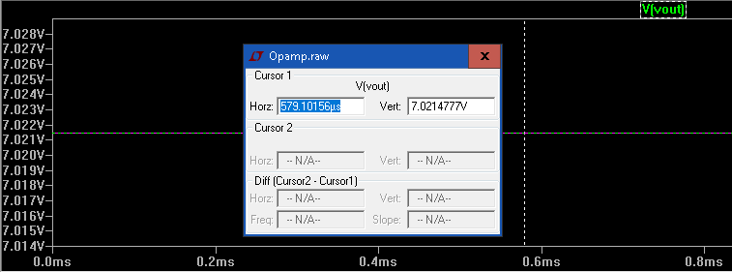
Experiment 7: Output Impedance
Change load resistor until you get ½ of maximum output (Rail voltage ~ 14V)

Slide 15
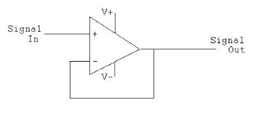
Principal 2: Negative Feedback
Can use negative feedback to control the gain.
With feedback, the opamp alters output so that input offset is between (+) and (-) input are the same
Gain = 1
If (+) > (-), output raises to positive rail. Once output is within “Input Offset Voltage” of (+), then output = (+)

Slide 16
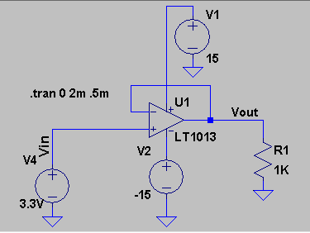
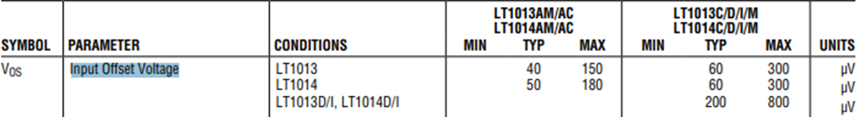
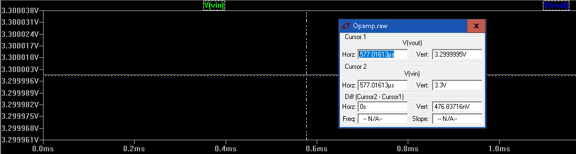
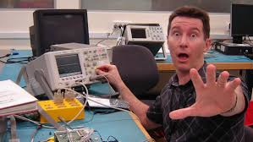
Experiment 8: DC Voltage Follower or Buffer
Don’t have to swing to rail. Only swing to 3.3V
Stay away from the rails for more accuracy

Slide 17
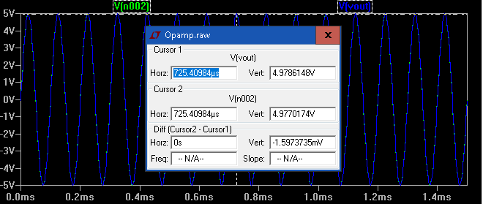
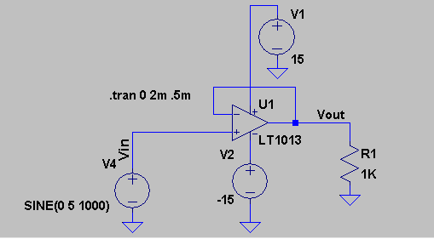
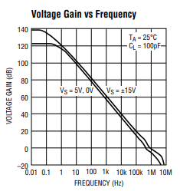

Experiment 9: AC Voltage Follower or Buffer
Don’t have to swing to rail. Only swing to 5V
Difference larger for 5V than 3.3V. Slew Rate?
HOMEWORK:
Create a voltage follower with a low frequency AC
Increase frequency and what happens to output when frequency is above 20 KHz?

Slide 18
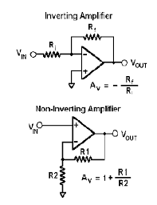
Principal 3: Gain and Negative Feedback
Feedback can be used to create gain for an inverting configuration or a non inverting configuration
With feedback, the opamp alters output so that input offset is between (+) and (-) input are the same
Use a voltage divider to feedback a fraction of the output voltage
Cavet emptor: Opamp may have low noise. Resistors add noise (thermal). Choose them wisely

Slide 19
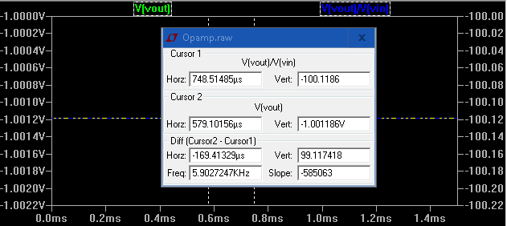
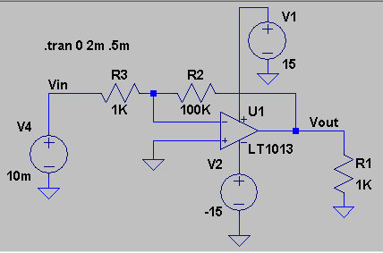
Experiment 10: Inverting Amplifier
Huh?
Inverting Gain = -R2/R1 = -100K/1K = 100
For 10mV input, output should be -10mVx100 = -1V
HOMEWORK:
Change input voltage. At what point does the voltage clip (i.e., hit the negative rail)
Change R2 and R3. What is the max gain you can get.
Introduce a small AC signal and see if gain is the same as DC gain

Slide 20
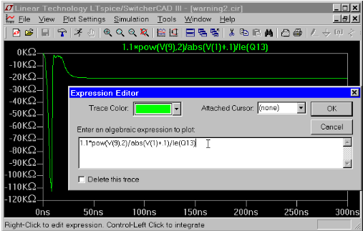
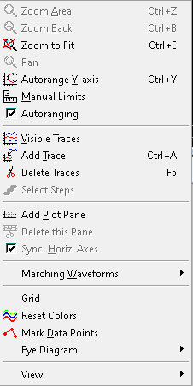
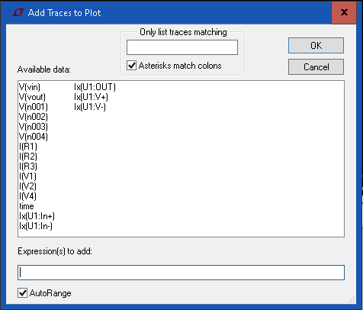
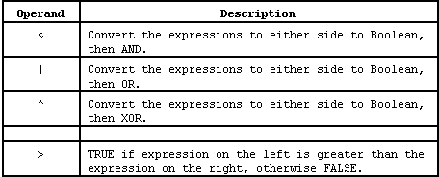
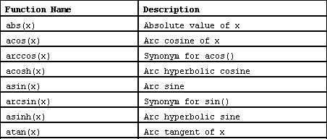
LTSPICE MINUTE: TRACE CALCULATION

Slide 21
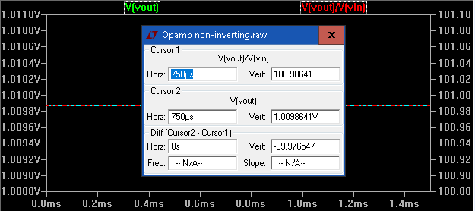
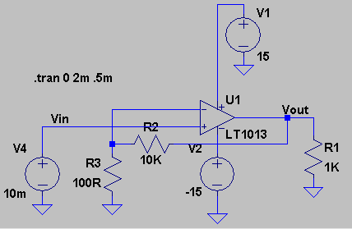
Experiment 11: Non-Inverting Amplifier
Non-Inverting Gain = 1+ R2/R1 = 1+ 10K/100 = 101
For 10mV input, output should be 10mx101 = +1.01V
HOMEWORK:
Same as inverting amplifier

Slide 22
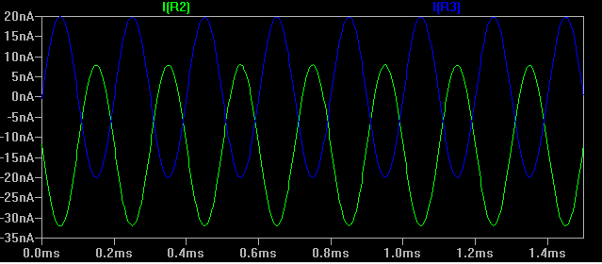
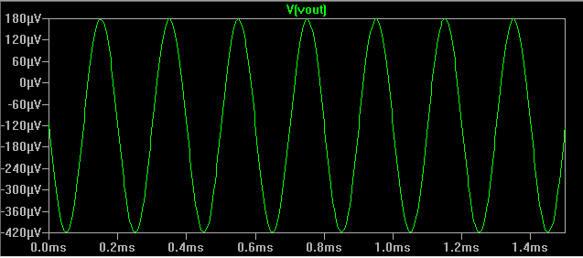
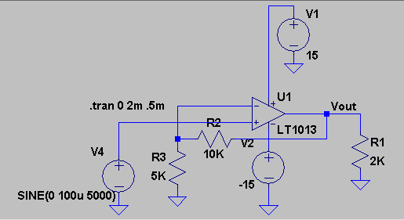
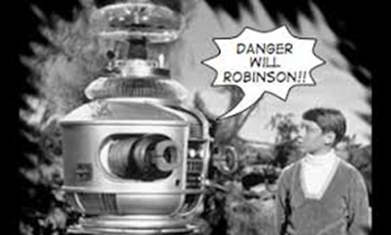
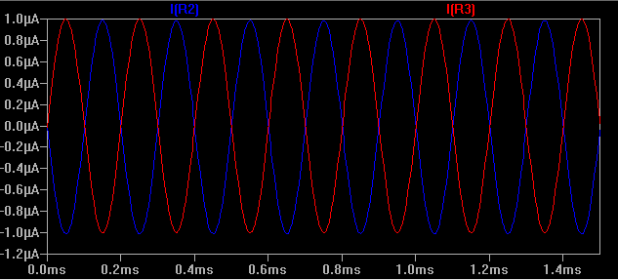
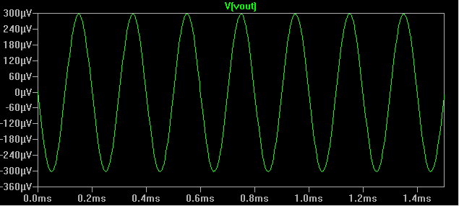
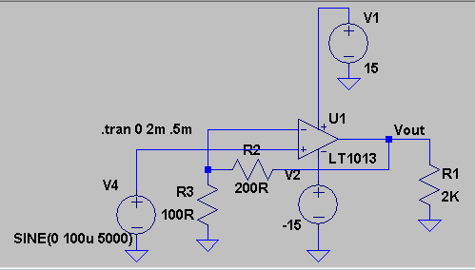
Finding 4: Current Sink
Will f**** you up!
~600 uV Peak-to-Peak
Resistor needs to be low enough to sink current for Non-Inverting Opamp
Small Signal
~600 uV Peak-to-Peak

Slide 23
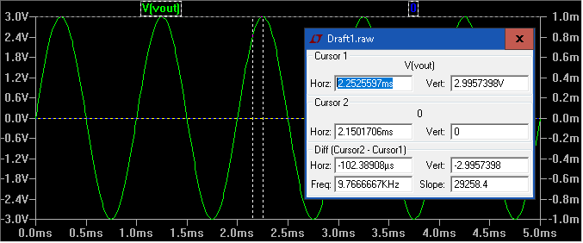


Single Supply
Opamps swing between Positive Rail and Negative Rail
For +Rail and –Rail, swing is around 0
Negative rails allows voltages to swing below 0
For single supply swing needs to be between +Rail and Gnd
Need to add ½ supply offset to input

Slide 24




Experiment 12: Single Supply
What happens if –Rail is 0 (ground)? What happens to the swing?
AC Short
Gain = 1 + 10K/100 = 101
Voltage Divider
DC Block
AC Short
p = 10m x 101=1.01
pp = 2 x p = 2.02

Slide 25


Experiment 13: Distortion
What happens If gain is too high?
Gain is 100x. Input is 80mV, Output is 8V.
Voltage swing is from 7.5V->0 and 7.5V -> 14
Not enough room to accommodate necessary swing so it clips at Rails

Slide 26
OPAMP LIMITATIONS
Frequency Limitation – Gain Bandwidth Product
Frequency & Output Voltage Limitation - Slew Rate
Noise

Slide 27




Experiment 14: Gain Bandwidth Product
Opamps gain vary with Frequency
60dB @ 1KHz
Gain = 20Log(100/10) = 40dB
1KHz & 100KHz
20dB @ 100KHz
1KHz
dB = 20Log(992/10) = 40dB
100KHz
dB = 20Log(97/10) = 19.7dB

Slide 28






Experiment 15: Slew Rate
Will f**** you up!
10 KHz
20 KHz

Slide 29




Experiment 16: SR Simplification
Sharp Impulse at 100 us for 3m.
Homework: Add feedback to this circuit and measure time

Slide 30
Finding 4: Slew Rate Calculation
Slew Rate = 0.3 V/us = 300,000 V/s
For 13 Volts,
F = SR/(2*PI*V) = 300,000 / (2 * 3.14 * 13) = 3.675 KHz
For 1 Volt, F = 47.771 KHz
For 5 Volts, F = 9.554 KHz
Homework: Create test circuit with gain and see how the output is impacted after these frequencies and voltages. **Don’t forget gain bandwidth product

Slide 31


Principal 4: Opamp Noise
All amplifiers introduce noise into a circuit that reduces SNR.
4
Amplification x10
40
SNR = 4/1 = 4
SNR= 40/10+ < 4
1
10
10 + amp_noise
Opamp
Feedback Network
Opamps introduce “White” Noise and “Pink” Noise. Noise is subject to gain with voltage and current noise added to input.
Feedback network introduces White Noise from resistors – Usually Largest
Low F - PINK
Higher F - White
Spectral Noise Density

Slide 32


Modeling Noise in Opamps
Current Noise and Voltage Noise
Resistor Voltage Noise
Resistor Voltage Noise
Resistor noise is about 4nV/rHz for 1K Resistor at room temp

Slide 33




Experiment 17: Calculate Opamp Noise
At the output: Spectral Noise Density:
Noise from resistors:
R1: 40nV/rHz
R2: 400nV/rHz
LT1013 Opamp current noise
7nV/rHz
LT1013 Opamp voltage noise
2200nV/rHz
Sum of Squares: 2236 nV/rHz (2.2uV/rHz)
Bandwidth

Slide 34



Experiment 18: Noise in Audio Range
Point to Trace Name and Press CTL-Click
Dumb it down: Multiply RMS noise by 6.6 to get peak-peak voltage
Peak-Peak Noise: 6.6x154uV = 1.02 mVpp

Slide 35
NOISE WRAP UP
All amplifiers introduce noise into a circuit that reduces SNR.
4
Amplification x10
40
SNR = 4/1 = 4
SNR= 40/10+ < 4
1
10
10 + amp_noise
Opamp
Feedback Network
We now know how much noise opamp will add!!

Slide 36
FIN

